Slide 1

DATA ENGINEERING 2
NOSQL
Laszlo Sallo
OCTOBER 2021

Slide 2

NOSQL

Slide 3
INTEGRITY AND CONSISTENCY
BASICALLY AVAILABLE
SOFT STATE
EVENTUAL CONSISTENCY
BASE

Slide 4
INTERFACE
SQL
ActionScript Bash C C# C++ Clojure Common Lisp Crystal D Dart Delphi Elixir emacs lisp Erlang Fancy gawk GNU Prolog Go Haskell Haxe Io Java Julia Lasso Lua Matlab mruby Nim Node.js Objective-C OCaml Pascal Perl PHP PL/SQL Pure Data Python R Racket Rebol Ruby Rust Scala Scheme Smalltalk Swift Tcl VB VCL Xojo …

Slide 5

SCHEMALESS OR SCHEMA FREE
A SMART DATABASE CAN FIGURE OUT
THE DATATYPE
THE STRUCTURE

Slide 6
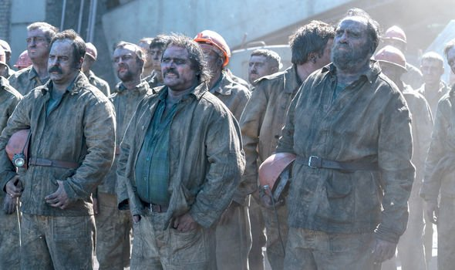
ALGORITHMS DEEP IN THE DATABASE
NO NEED TO MINE

Slide 7


MADE FOR CLOUD

Slide 8
NOSQL VARIETY
100s
OF NOSQL
SOLUTIONS
CLOUD BASED
TIME SERIES DB WITH
TIME AGGREGATION FUNCTIONS
USING SQL
SCHEMA FREE JSON
DOCUMENT STORE
GRAPH DATABASE WITH GQL AND
NETWORK VISUALIZATION
1
2
3

Slide 9
NOSQL CLASSIFICATION
KEY-VALUE STORES
TIME SERIES DBMS
DOCUMENT STORES
COLUMN STORES
SEARCH ENGINES
GRAPH DBMS

Slide 10
DB-ENGINES.COM
YOUR ULTIMATE SOURCE TO
EXPLORE
http://db-engines.com/en/system/MySQL
http://db-engines.com/en/system/Elasticsearch
CATEGORIZE / KNOW THE TRENDS
http://db-engines.com/en/ranking_categories
http://db-engines.com/en/ranking_osvsc
http://db-engines.com/en/ranking_trend
COMPARE
http://db-engines.com/en/system/Elasticsearch%3BMongoDB

Slide 11
EXERCISE
CAN I INSTALL REDSHIFT ON MY LAPTOP ?
WHAT ARE THE TYPICAL APPLICATION SCENARIOS FOR CASSANDRA ?
CAN NEO4J PARTION DATA OVER MULTIPLE NODES ?

Slide 12
THE NEW TOOLS
NOSQL
SET OF SOLUTIONS
PERFORMANCE ORIENTED
DATABASE
OPERATIONAL AND ANALYTICAL
STRUCTURED/ SEMI-STRUCTURED
BIG DATA
SET OF SOLUTIONS
DATA VOLUME ORIENTED
DATA FRAMEWORK
ANALYTICAL
MAINLY UNSTRUCTURED

Slide 13
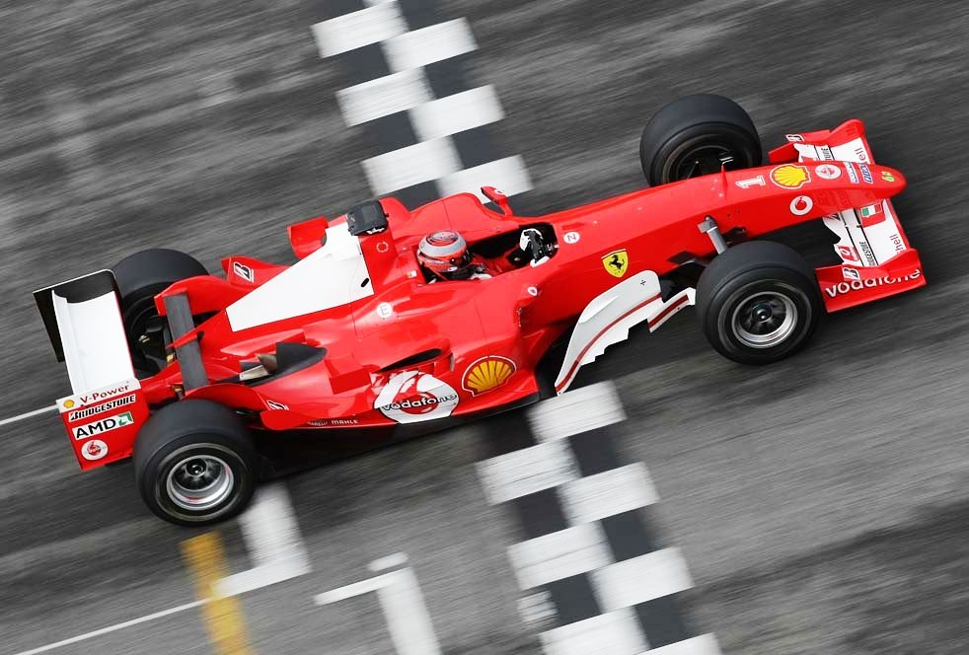
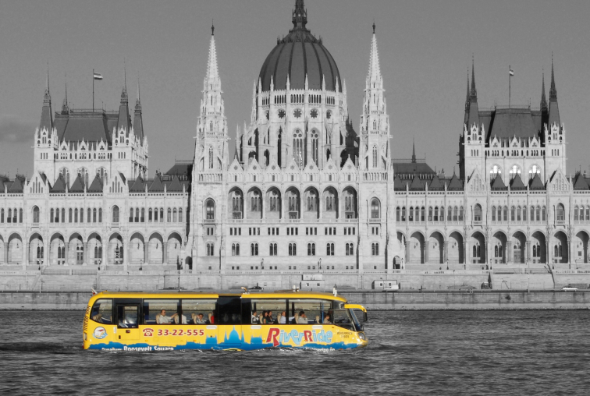
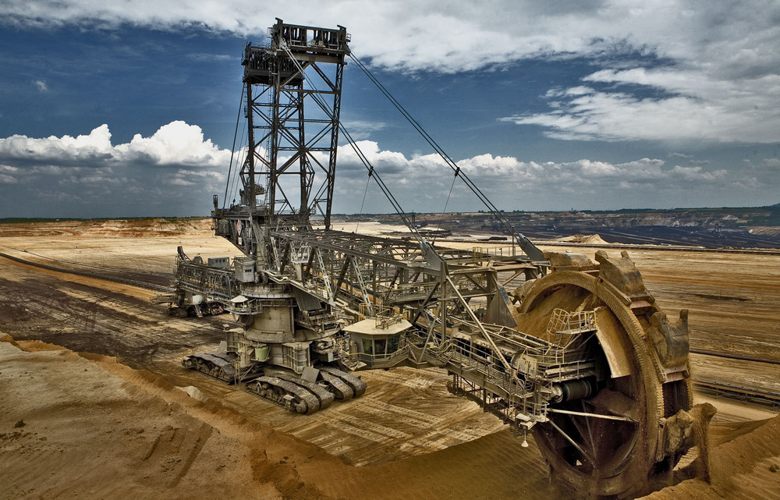
GAME
WHICH ONE YOU
WOULD ASSOCIATE
WITH
RDBMS,
NOSQL,
BIGDATA ?
1
2
3

Slide 14
NOSQL CLASSIFICATION
KEY-VALUE STORES
TIME SERIES DBMS
DOCUMENT STORES
COLUMN STORES
SEARCH ENGINES
GRAPH DBMS

Slide 15
KEY-VALUE DATA FORM - EXAMPLES
key | value
1 | John
2 | Mary
3 | Peter
key | value
War and Peace | ‘Well, Prince, so Genoa and Lucca are now just family …”
The Master and Margarita | “At the sunset hour of one warm spring day two men were to be seen …”
The Winter of Our Discontent | “I wonder how many people I've looked at all my life and never seen.”

Slide 16
KEY-VALUE STORE FEATURES
SIMPLEST DBMS VARIANT
EASY TO SCALE
HIGH PERFORMANCE

Slide 17
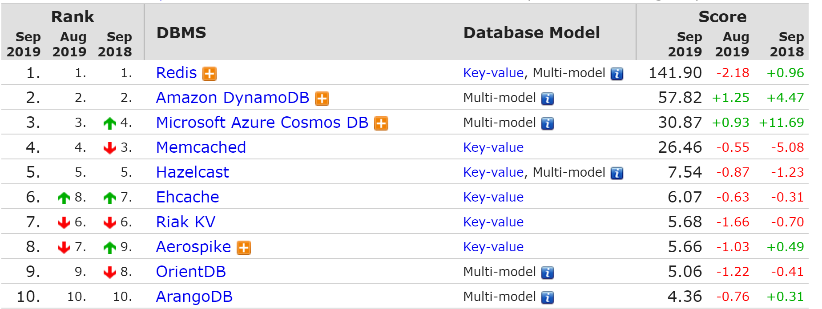
KEY-VALUE STORE RANK

Slide 18
REDIS
IN MEMORY (VERY FAST )
SUPPORTS TRANSACTION
EXPIRING KEY

Slide 19






REDIS IN CLOUD

Slide 20
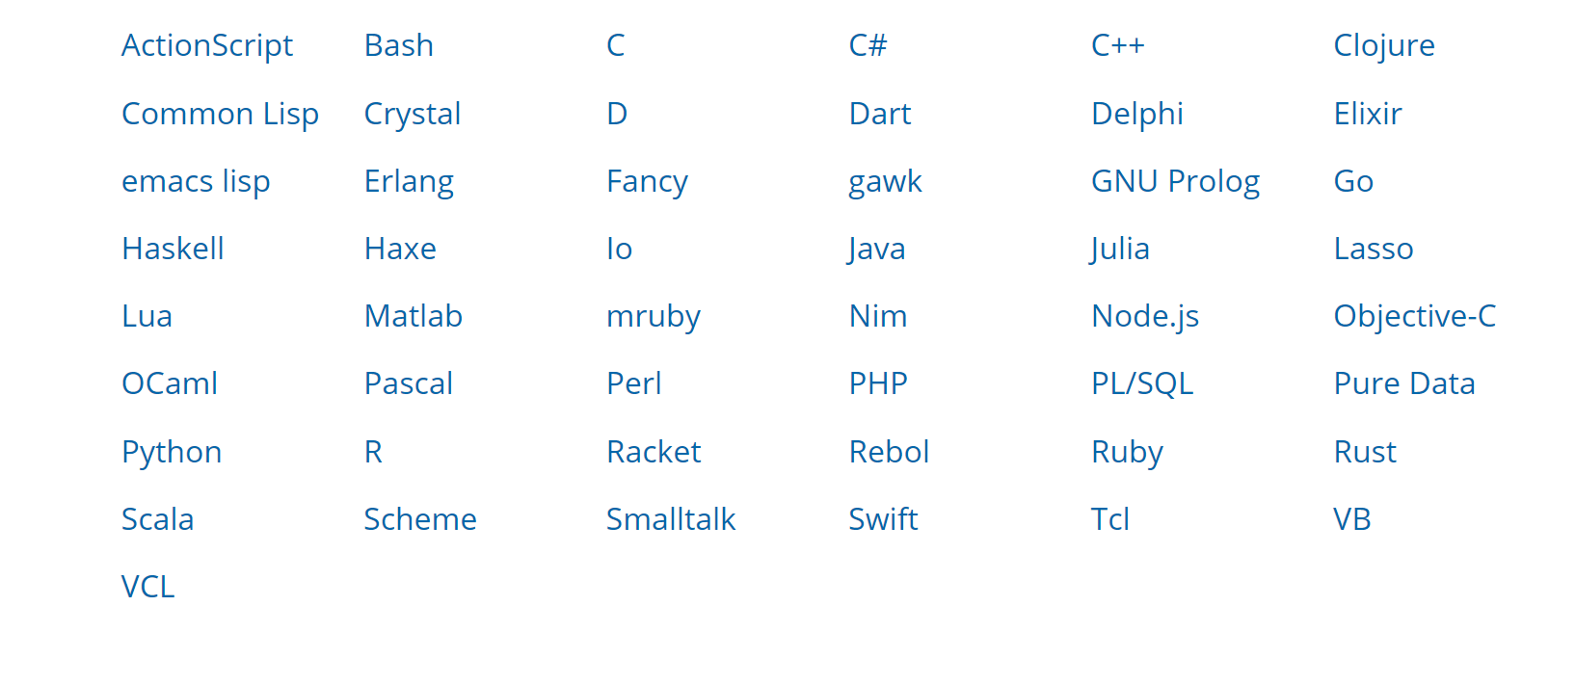
ACCESS REDIS

Slide 21
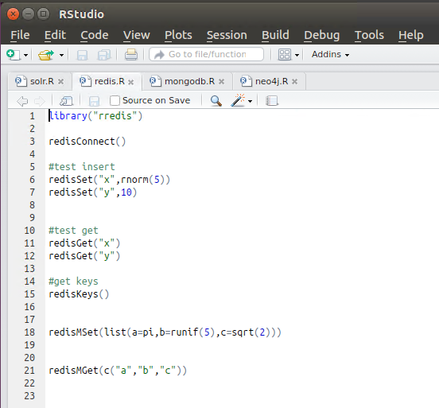
R STUDIO

Slide 22

REDIS PRACTICE WITH ZEPPELIN NOTEBOOK

Slide 23

SUITABLE USE CASES
USER PROFILE FOR
UI
USER PROFILE
TAG
SEARCH ENGINE
AS OF 2013 PINTEREST HAD 8000+ REDIS SHARDS ON AMAZON CLOUD

Slide 24
SUITABLE USE CASES
MESSAGING
PROCESSOR
DB
SOURCE
QUEUE
PROCESSOR
QUEUE DB

Slide 25
SUITABLE USE CASES
RESPONSE CACHE
DW
SELECT ITEM FROM SALES WHERE COUNTRY=‘HU’
REPORT
Sales ID | Country | Item
1 | HU | Chair
2 | HU | Flower
3 | HU | Space ship
4 | HU | Oracle DB

Slide 26
SUITABLE USE CASES
RESPONSE CACHE
DW
REPORT
CACHE
KEY: QUERY
VALUE: RESULT

Slide 27
USAGE
DO NOT USE WHEN YOU …
HAVE TO QUERY FOR RELATIONSHIPS
HAVE TO QUERY FOR HIERARCHY
HAVE TO QUERY BY MULTIPLE DIMENSIONS
WHEN YOU CANNOT CREATE DISTINCT KEYS

Slide 28
NOSQL CLASSIFICATION
KEY-VALUE STORES
TIME SERIES DBMS
DOCUMENT STORES
COLUMN STORES
SEARCH ENGINES
GRAPH DBMS

Slide 29
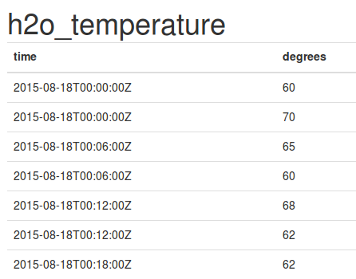
TIME SERIES DBMS
KEY: TIME
VALUE: TIME SERIES DATA (MEASUREMENT, EVENT ETC)

Slide 30
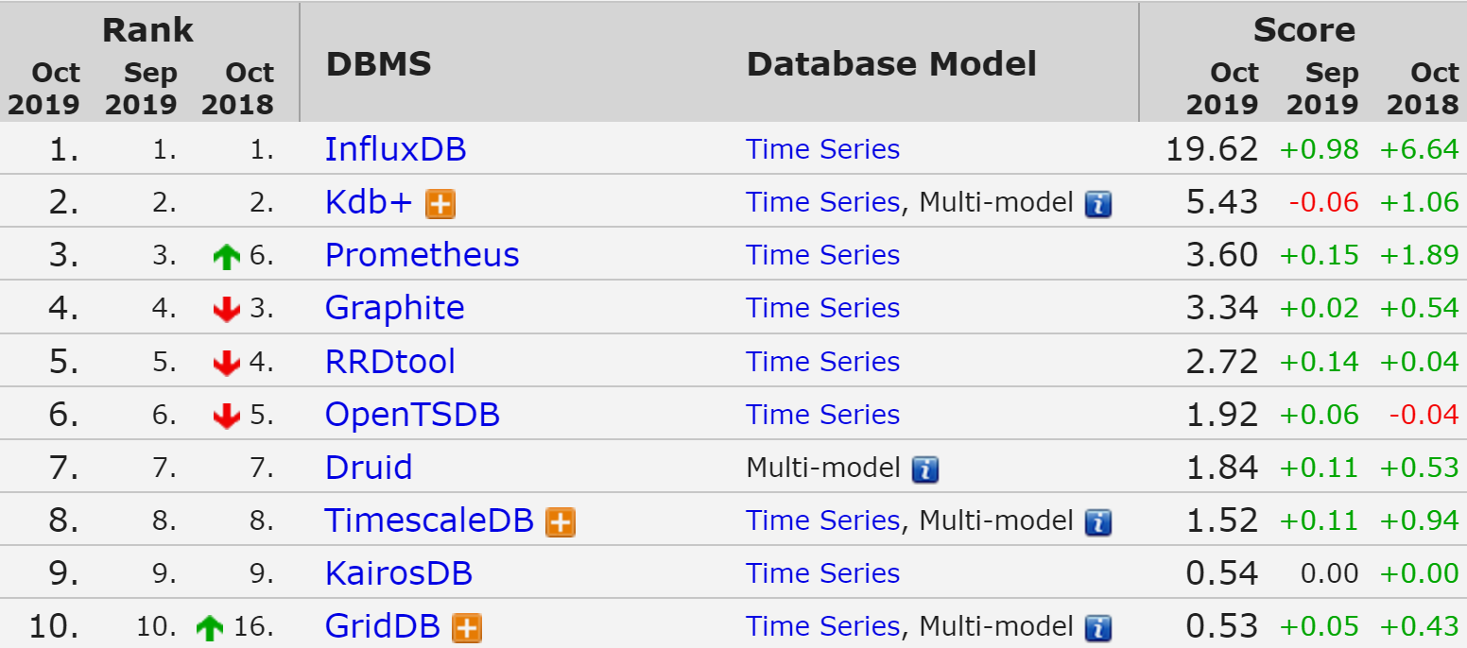
TIME SERIES DBMS

Slide 31
TIME SERIES DBMS - FEATURES
QUERY BY TIME
HIGH PERFORMING WRITE
STATISTICAL OPERATION ON TIME SERIES

Slide 32
INFLUX DB FUNCTIONS
Aggregations | Selectors | Transformations | Predictors | Technical Analysis
COUNT() | BOTTOM() | ABS() | HOLT_WINTERS() | CHANDE_MOMENTUM_OSCILLATOR()
DISTINCT() | FIRST() | ACOS() |  | EXPONENTIAL_MOVING_AVERAGE()
INTEGRAL() | LAST() | ASIN() |  | DOUBLE_EXPONENTIAL_MOVING_AVERAGE()
MEAN() | MAX() | ATAN() |  | KAUFMANS_EFFICIENCY_RATIO()
MEDIAN() | MIN() | ATAN2() |  | KAUFMANS_ADAPTIVE_MOVING_AVERAGE()
MODE() | PERCENTILE() | CEIL() |  | TRIPLE_EXPONENTIAL_MOVING_AVERAGE()
SPREAD() | SAMPLE() | COS() |  | TRIPLE_EXPONENTIAL_DERIVATIVE()
STDDEV() | TOP() | CUMULATIVE_SUM() |  | RELATIVE_STRENGTH_INDEX()
SUM() |  | DERIVATIVE()
 |  | DIFFERENCE()
 |  | ELAPSED()
 |  | EXP()
 |  | FLOOR()
 |  | HISTOGRAM()
 |  | LN()
 |  | LOG()
 |  | LOG2()
 |  | LOG10()
 |  | MOVING_AVERAGE()
 |  | NON_NEGATIVE_DERIVATIVE()
 |  | NON_NEGATIVE_DIFFERENCE()
 |  | POW()
 |  | ROUND()
 |  | SIN()
 |  | SQRT()
 |  | TAN()

Slide 33
INFLUX
DOWNSAMPLING AND DATA RETENTION
SQL LIKE QUERIES
ECOSYSTEM FOR ACQUISITION,
STORAGE,
PROCESSING,
AND VISUALIZATION

Slide 34
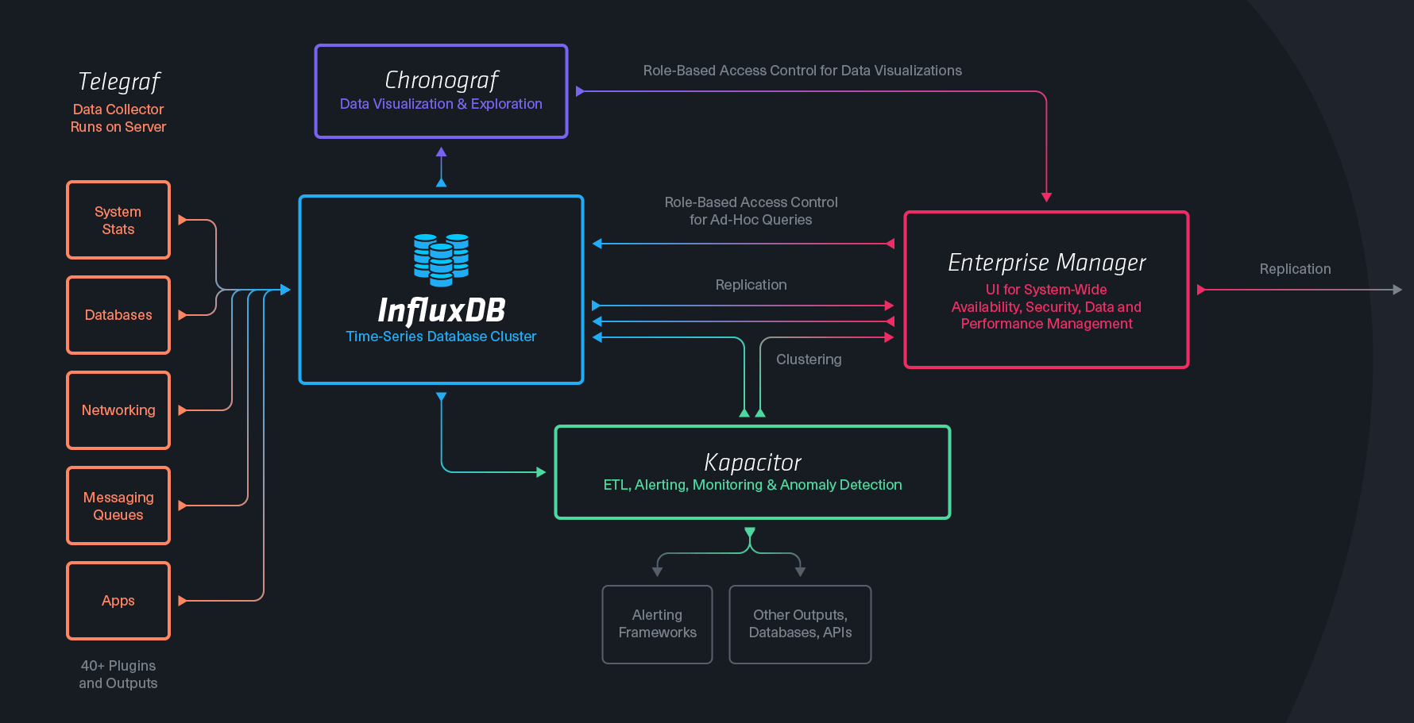
INFLUX TICK STACK

Slide 35
TERMINOLOGY
SQL SERVER | INFLUX
Database | Database
Table | Measurement
Index | Index
Row | Point
Column | Field,Tag
Joining | Join
Partition | Sharding

Slide 36

INFLUXDB PRACTICE

Slide 37

USE CASE EXAMPLE
VISUALIZE
IoT
Metrics Influx
(Aggregate)
PROCESSOR
SENSORS
Event Influx
(Interpret)
QUEUE
PROCESSOR
KEY VALUE
MONITOR

Slide 38
USAGE
TIME SERIES DATA FLUX WHICH YOU WANT TO
VISUALIZE TRANSFORM / AGGREGATE
DO REAL TIME ANALYTICS

Slide 39
USE CASES
IOT
SYSTEM / INFRASTRUCTURE MONITORING
SMART CITY
INDUSTRY 4.0
ANOMALY DETECTION
TRADING DATA

Slide 40
USAGE
DO NOT USE WHEN YOU …
DON’T HAVE TIME SERIES DATA FLUX
NEED TRANSACTION

Slide 41
NOSQL CLASSIFICATION
KEY-VALUE STORES
TIME SERIES DBMS
DOCUMENT STORES
COLUMN STORES
SEARCH ENGINES
GRAPH DBMS

Slide 42
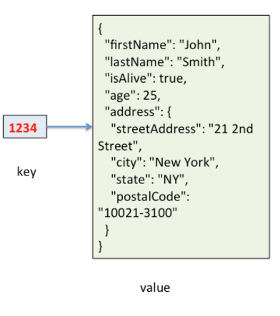
DOCUMENT STORES
KEY: ID
VALUE: QUERYABLE STRUCTURED DOCUMENT

Slide 43
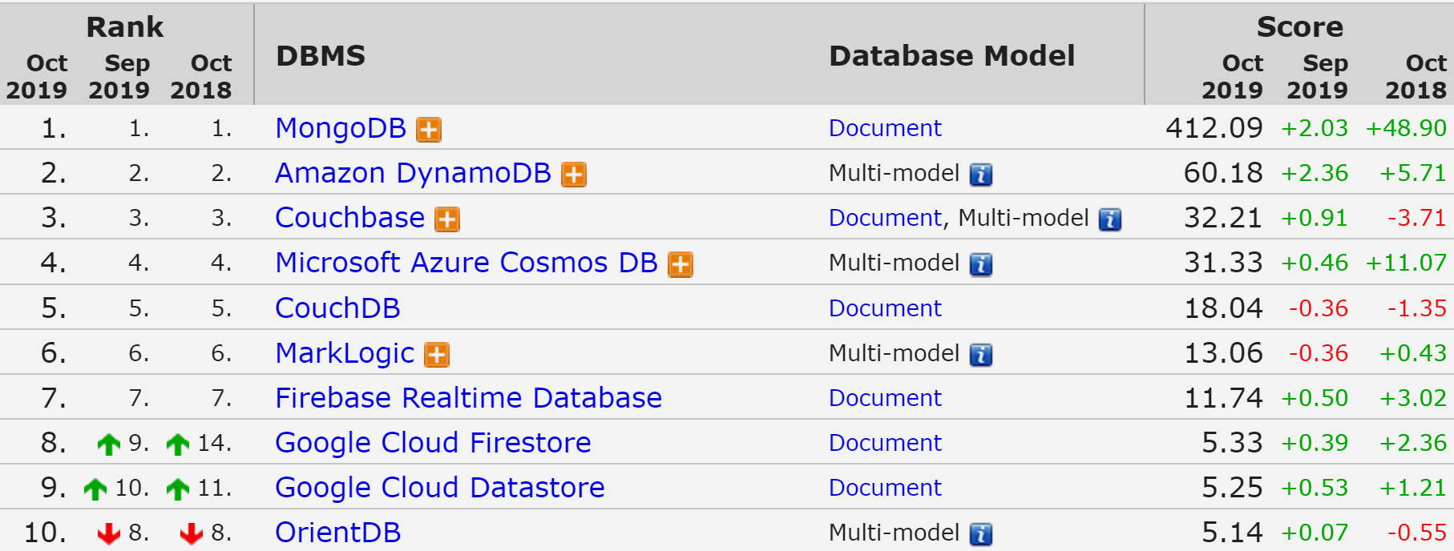
DOCUMENT STORES

Slide 44
MONGODB
THE MOST USED NOSQL
CLOSER TO GENERAL PURPOSE / SLOWER
HIGH AVAILABILITY / AUTOMATIC FAILOVER
HIGHLY SCALABLE / REBALANCING
SELECTABLE CONSISTENCY
NO TRANSACTION SUPPORT
DYNAMIC SCHEMA

Slide 45
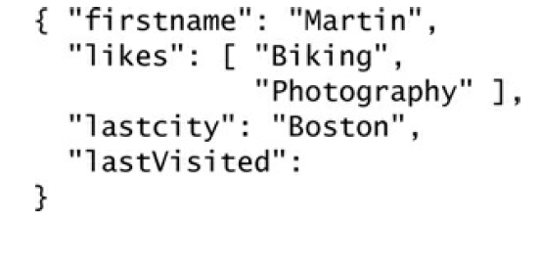
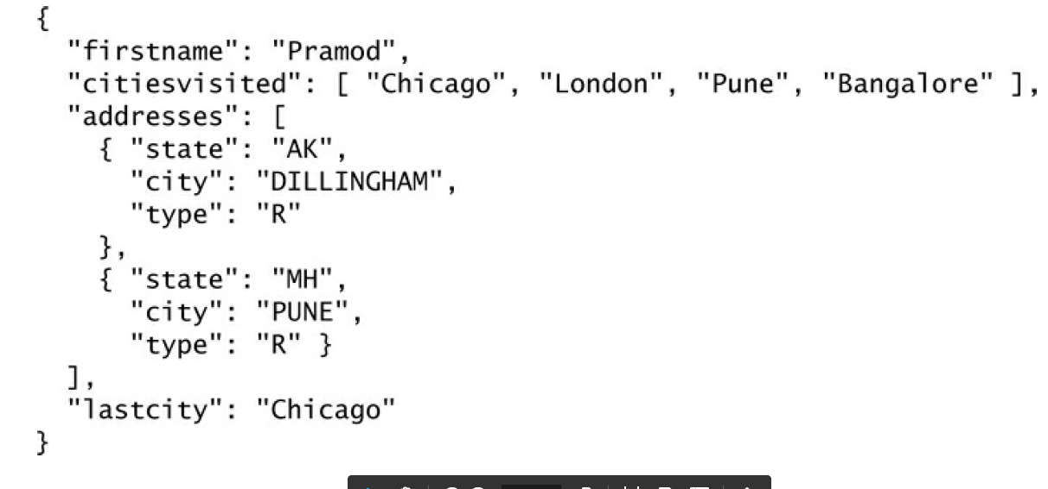
DYNAMIC SCHEMA
BE CAREFUL!

Slide 46
TERMINOLOGY
SQL SERVER | MONGODB
Database | Database
Table | Collection
Index | Index
Row | Document
Column | Field
Joining | Linking & Embedding
Partition | Sharding

Slide 47




MONGO ACCESS
BI TOOLS
PROGRAMING LANGUAGES

Slide 48

MONGO PRACTICE

Slide 49
USAGE
WHEN YOU WANT TO STORE/QUERY HIGH VOLUME OF MULTIDIMENSIONAL DATA
AND
FAILOVER, HIGH AVAILABILITY AND CONSISTENCY MATTERS FOR YOU

Slide 50



USES CASES
https://www.mongodb.com/industries/

Slide 51
WHEN NOT TO USE
DO NOT USE WHEN
MONGO CAN’T HANDLE YOUR DATA SIZE
YOU NEED TRANSACTIONS
YOU NEED COMPLEX AGGREGATIONS
YOU HAVE COMPLEX RELATIONS

Slide 52
NOSQL CLASSIFICATION
KEY-VALUE STORES
TIME SERIES DBMS
DOCUMENT STORES
COLUMN STORES
SEARCH ENGINES
GRAPH DBMS

Slide 53
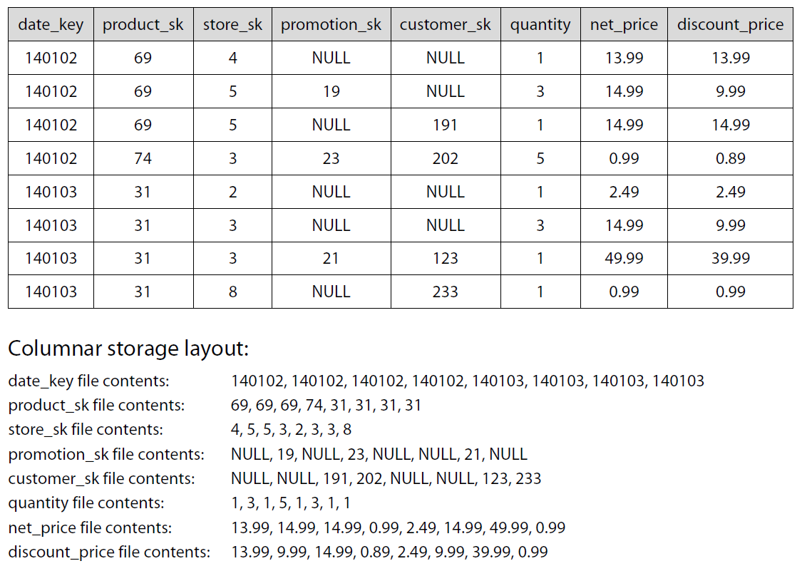
CLASSICAL DATA TABLE
140102 69 4 NULL NULL 1 13.99 13.99 140102 69 5 19 NULL 3 14.99 9.99 140102 69 5 NULL 191 1 14.99 14.99 140102 74 3 23 202 5 0.99 0.89 140103 31 2 NULL NULL 1 2.49 2.49 140103 31 3 NULL NULL 3 14.99 9.99 140103 31 3 21 123 1 49.99 39.99 140103 31 8 NULL 233 1 0.99 0.99
DISCOUNT PRICES FOR LAST DAY ?

Slide 54
WIDE COLUMN STORES

Slide 55
COMPARE DISK ACCESS
CLASSICAL TABULAR DATA
140102 69 4 NULL NULL 1 13.99 13.99 140102 69 5 19 NULL 3 14.99 9.99 140102 69 5 NULL 191 1 14.99 14.99 140102 74 3 23 202 5 0.99 0.89 140103 31 2 NULL NULL 1 2.49 2.49 140103 31 3 NULL NULL 3 14.99 9.99 140103 31 3 21 123 1 49.99 39.99 140103 31 8 NULL 233 1 0.99 0.99
WIDE COLUMN STORES
140102 140102 140102 140102 140103 140103 140103 140103 69 69 69 74 31 31 31 31 4 5 5 3 2 3 3 8 NULL 19 NULL 23 NULL NULL 21 NULL NULL NULL 191 202 NULL NULL 123 233 1 3 1 5 1 3 1 1 13.99 14.99 14.99 0.99 2.49 14.99 49.99 0.99 13.99 9.99 14.99 0.89 2.49 9.99 39.99 0.99

Slide 56
COMPRESSION
CLASSICAL TABULAR DATA
140102 69 4 NULL NULL 1 13.99 13.99 140102 69 5 19 NULL 3 14.99 9.99 140102 69 5 NULL 191 1 14.99 14.99 140102 74 3 23 202 5 0.99 0.89 140103 31 2 NULL NULL 1 2.49 2.49 140103 31 3 NULL NULL 1 14.99 9.99 140103 31 3 21 123 1 49.99 39.99 140103 31 8 NULL 233 1 0.99 0.99
WIDE COLUMN STORES
140102 140102 140102 140102 140103 140103 140103 140103 69 69 69 74 31 31 31 31 4 5 5 3 2 3 3 8 NULL 19 NULL 23 NULL NULL 21 NULL NULL NULL 191 202 NULL NULL 123 233 1 3 1 5 1 1 1 1 13.99 14.99 14.99 0.99 2.49 14.99 49.99 0.99 13.99 9.99 14.99 0.89 2.49 9.99 39.99 0.99

Slide 57
KEY FEAUTRES
FASTER ACCESS TIME WHEN YOU QUERY A FEW NEED DIMENSIONS
READ OPTIMIZED
HIGHLY SCALABLE BY DIMENSION
COMPRESSION
NEW GENERATION OF DW

Slide 58
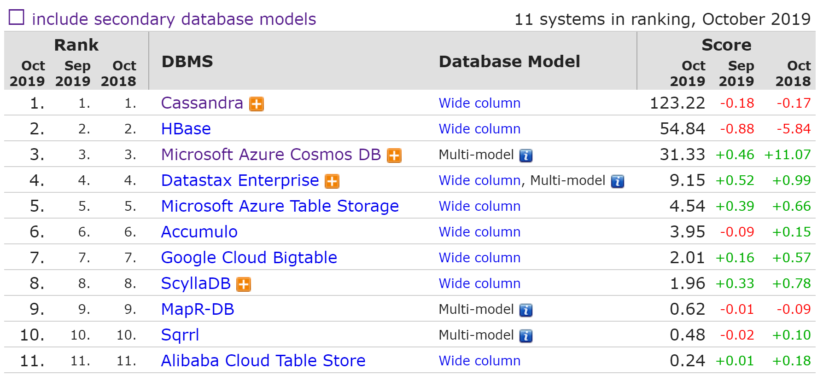
WIDE COLUMN STORE RANK

Slide 59
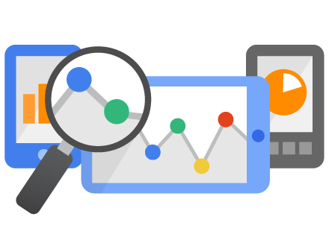
USE CASE – GOOGLE ANALYTICS

Slide 60
NOSQL CLASSIFICATION
KEY-VALUE STORES
TIME SERIES DBMS
DOCUMENT STORES
COLUMN STORES
SEARCH ENGINES
GRAPH DBMS

Slide 61



MANY BUILT-IN FUNCTIONS
Facet search
Text Analysis
Geospatial Search
+ Build your own

Slide 62
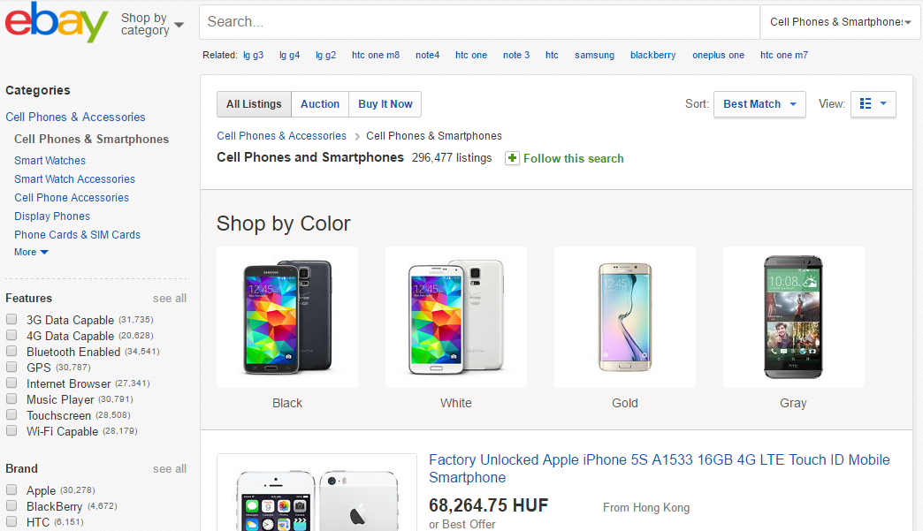
FACETED SEARCH

Slide 63
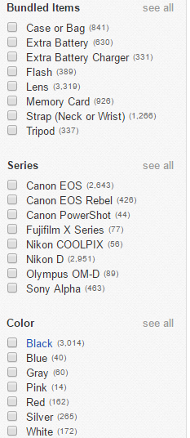
FACETED SEARCH
GUIDED QUERIES
E-COMMERCE: GUIDE YOUR CUSTOMERS
ANALYTICS: SLICING AND DICING, SELF SERVICE BI

Slide 64
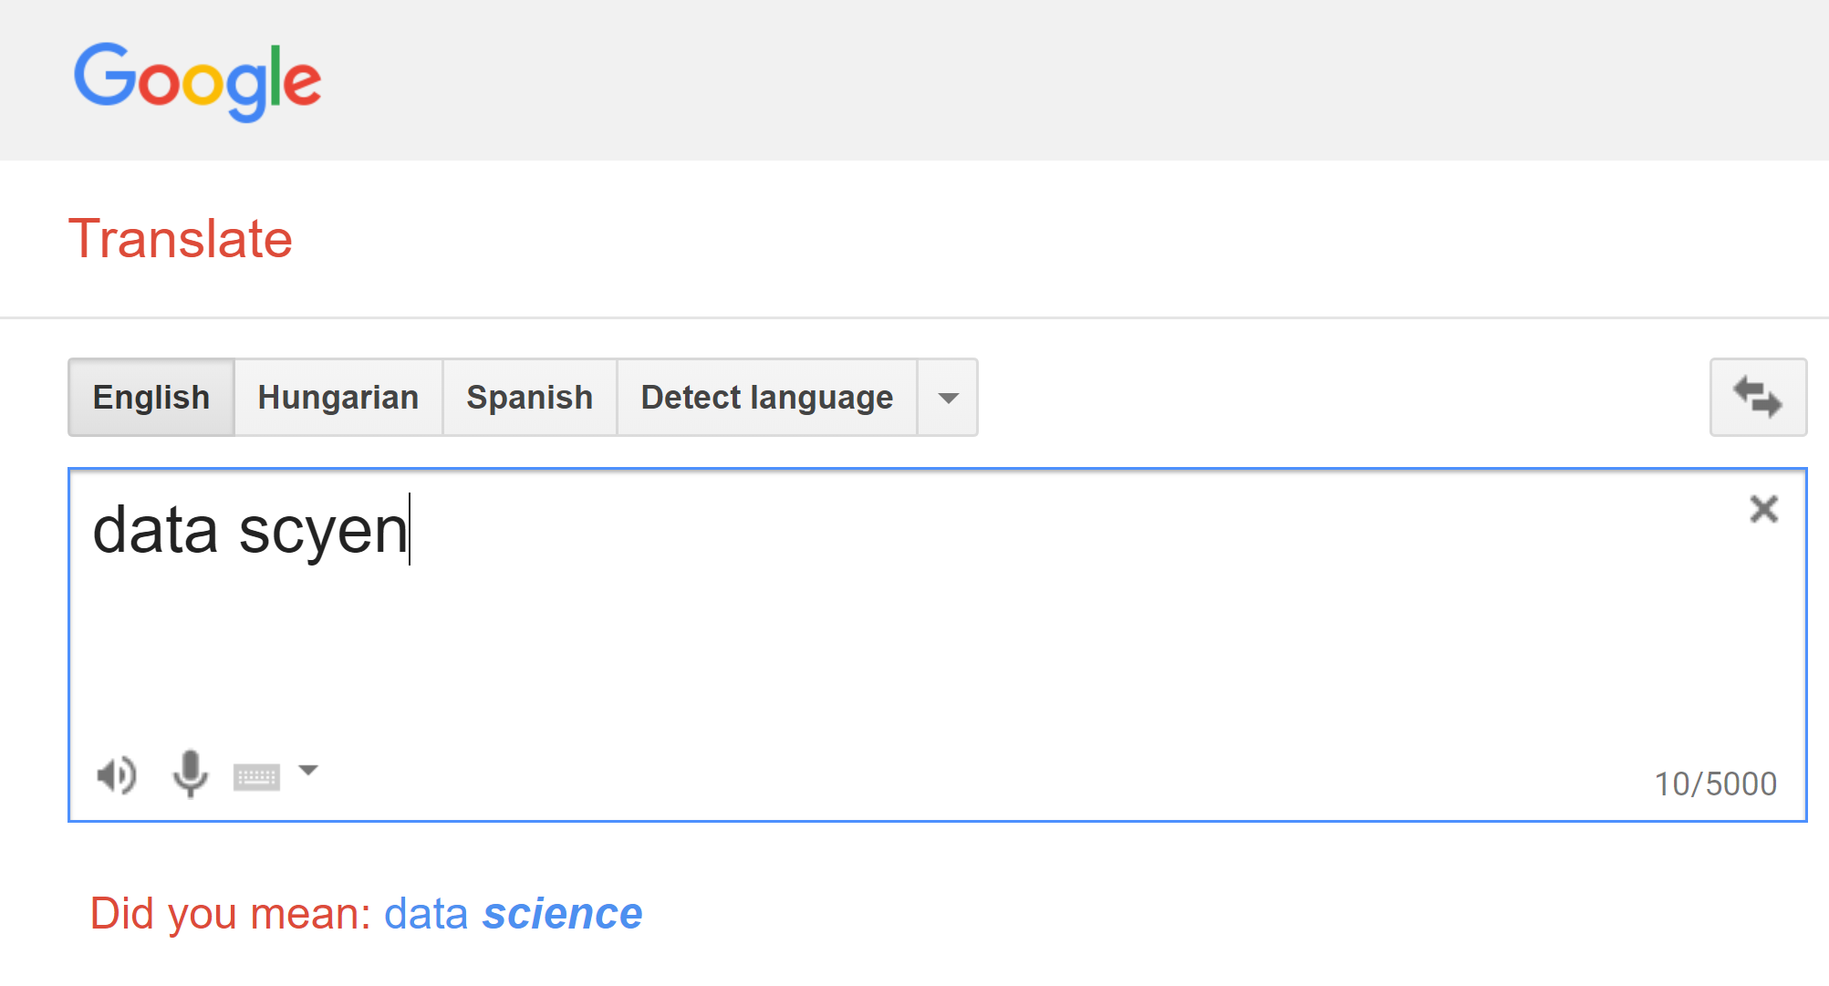
TEXT FUNCTIONS

Slide 65
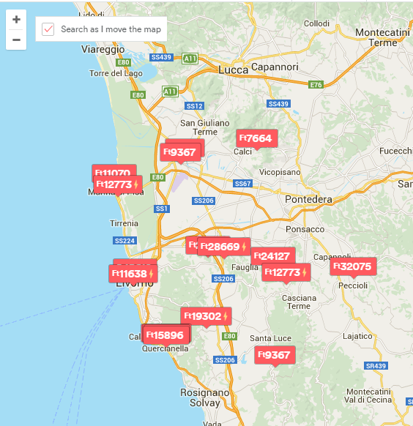
GEOSPATIAL SEARCH
COORDINATES TO EACH RECORD
QUERY:
AREA BY DIFFERENT SHAPES
PROXIMITY

Slide 66
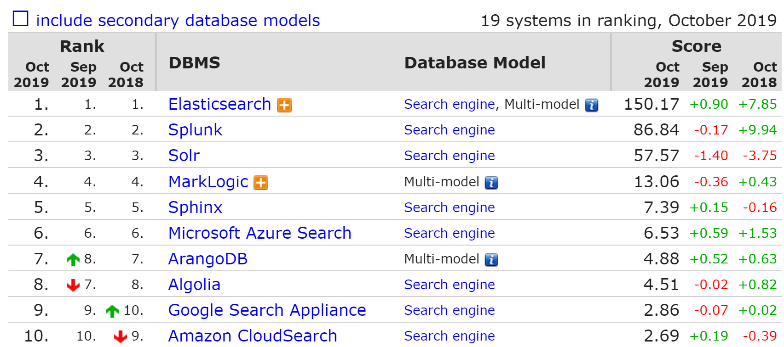
SEARCH ENGINES RANK

Slide 67

PRACTICE

Slide 68
WHEN TO USE SEARCH ENGINES
WHEN YOU NEED COMPLEX DOCUMENT QUERIES
E-COMMERCE (EBAY, EXPEDIA)
ANALYTICS (NETFLIX)
TEXT SEARCH (WIKIPEDIA)

Slide 69
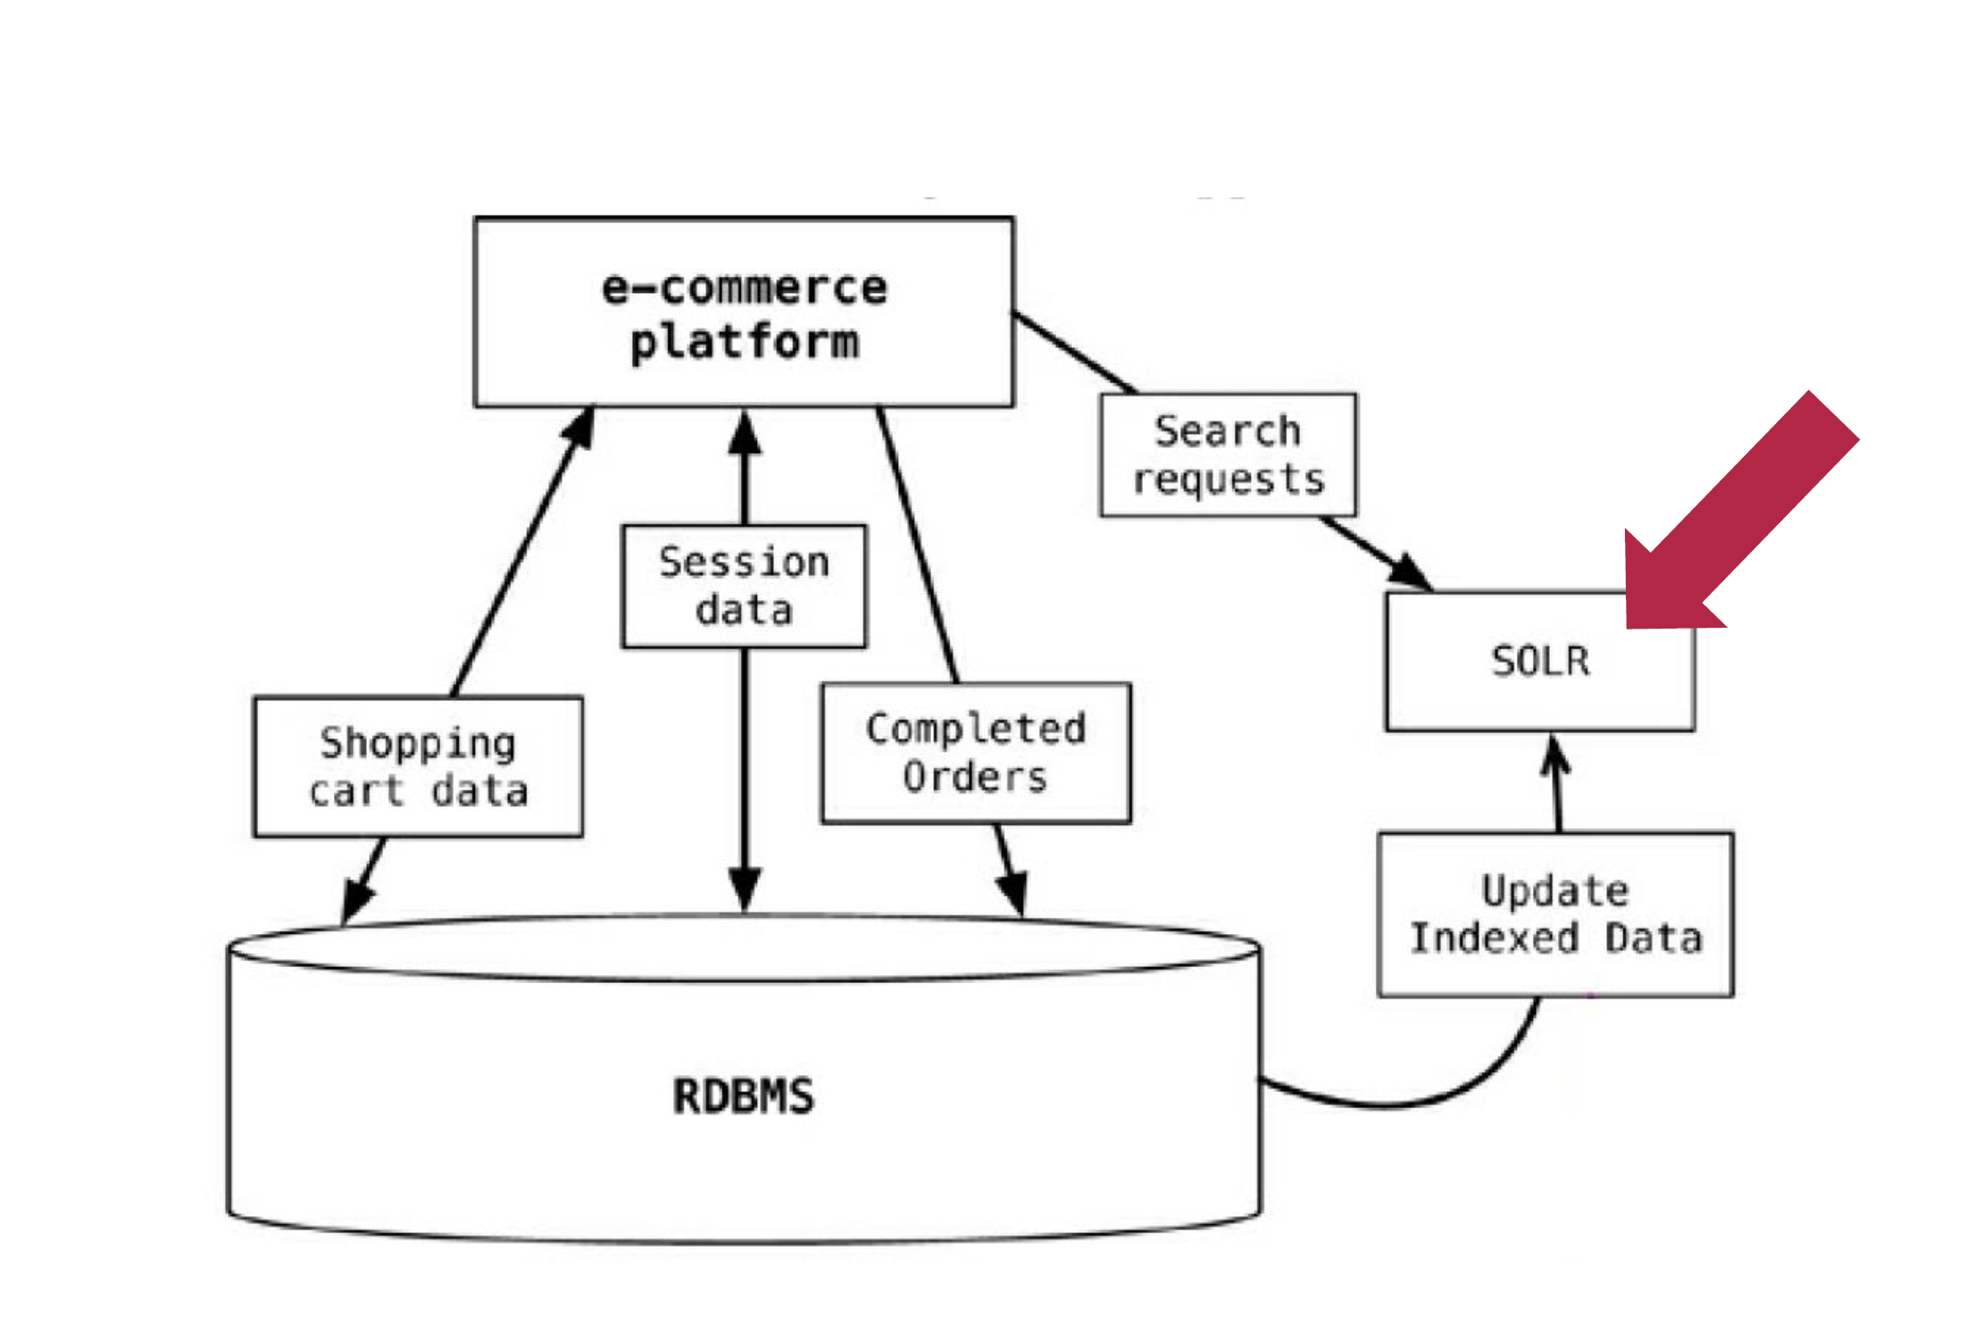
USECASE - ECOMMERCE

Slide 70
NOSQL CLASSIFICATION
KEY-VALUE STORES
TIME SERIES DBMS
DOCUMENT STORES
COLUMN STORES
SEARCH ENGINES
GRAPH DBMS

Slide 71
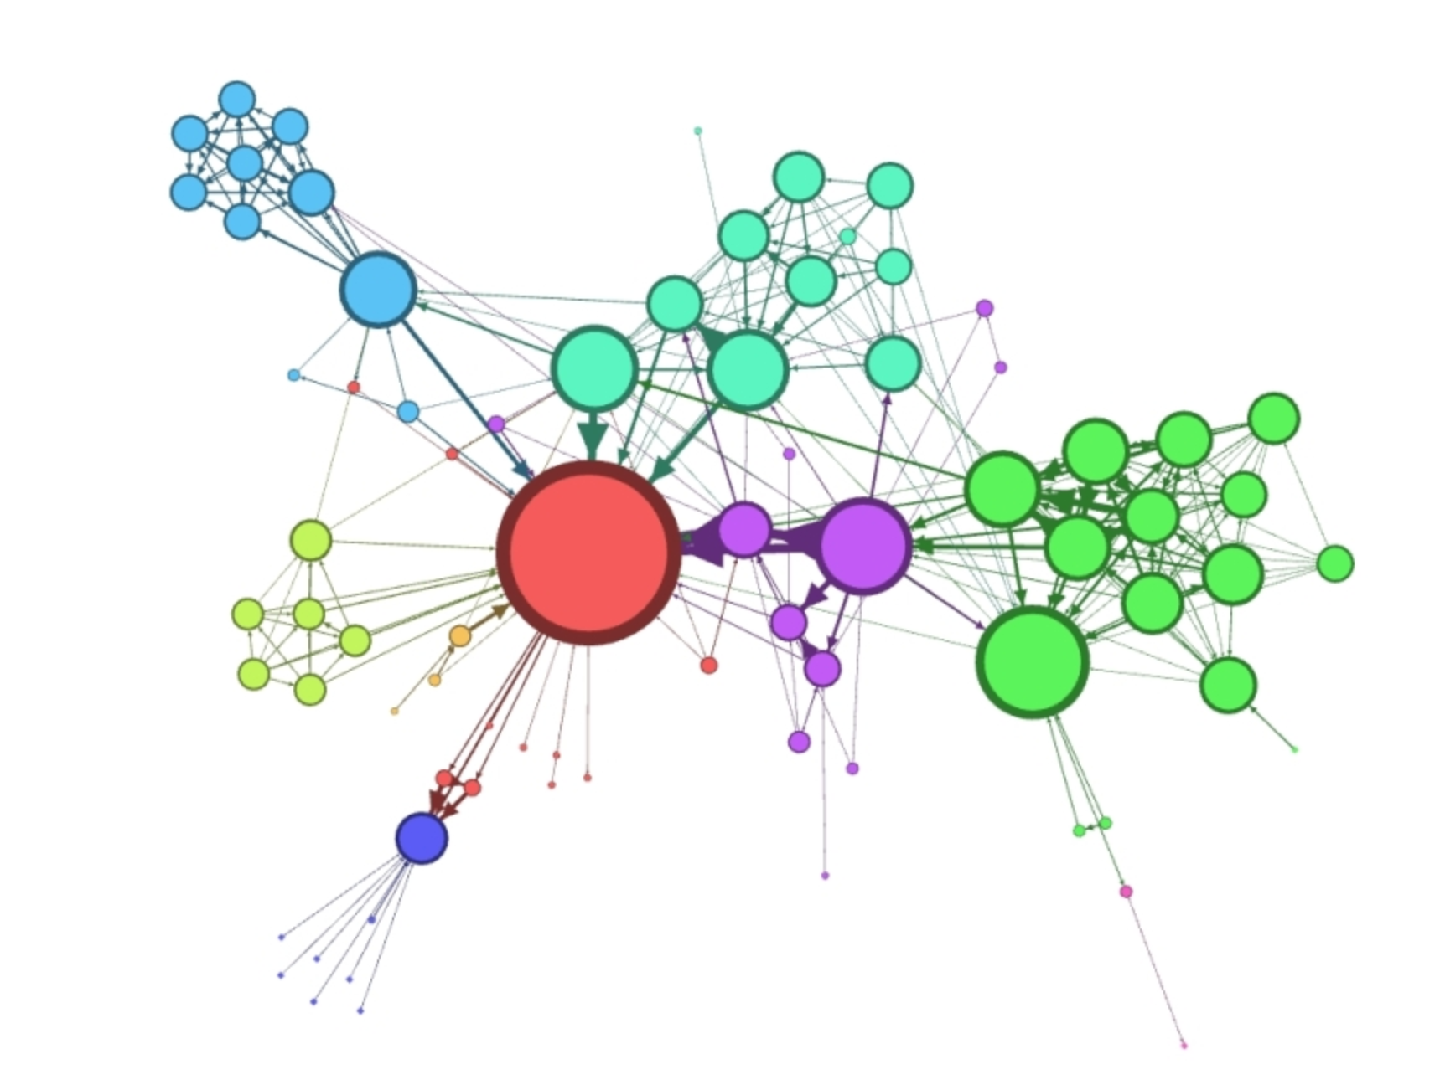
GRAPH DATA STRUCTURES

Slide 72

NETWORK SCIENCE
HOW KEVIN BACON CHANGED DATA SCIENCE ?

Slide 73

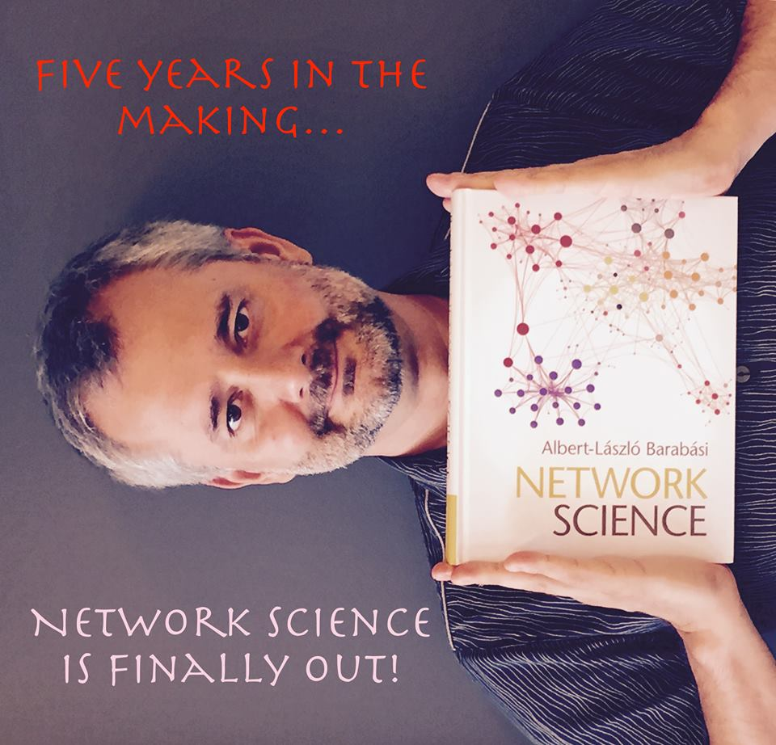
BOOKS

Slide 74
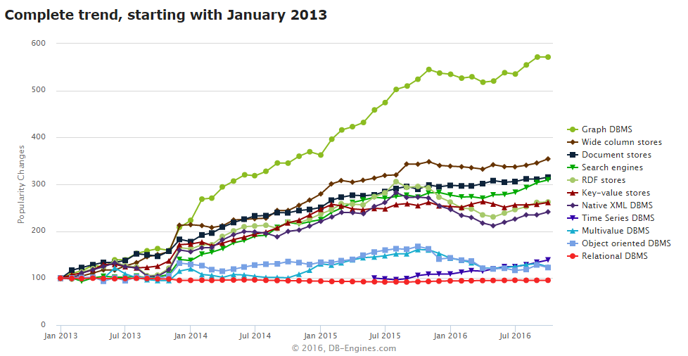
DATA SCIENCE
NEW
TYPE
ANALYTICS

Slide 75
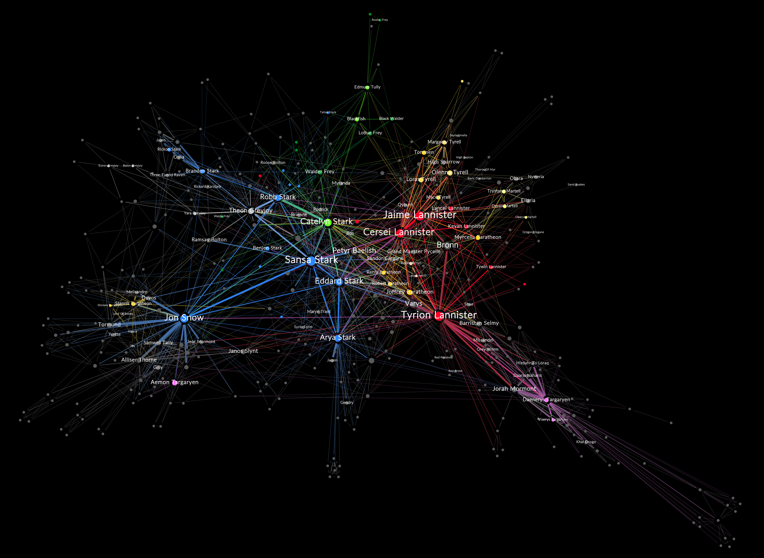
FEATURE ENGINEERING

Slide 76


ROBUSTNESS TESTING
Notes:
INSTEAD OF EXPLORING EMPIRICALLY

Slide 77
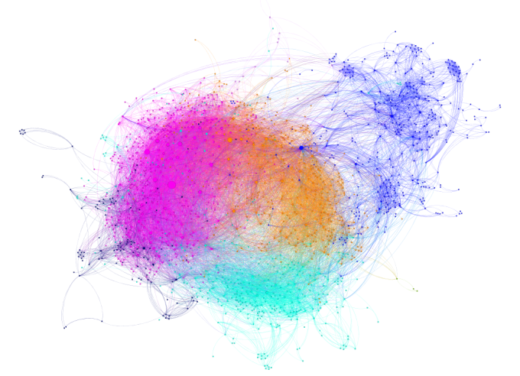
SEGMENTATION / FRAUD DETECTION

Slide 78
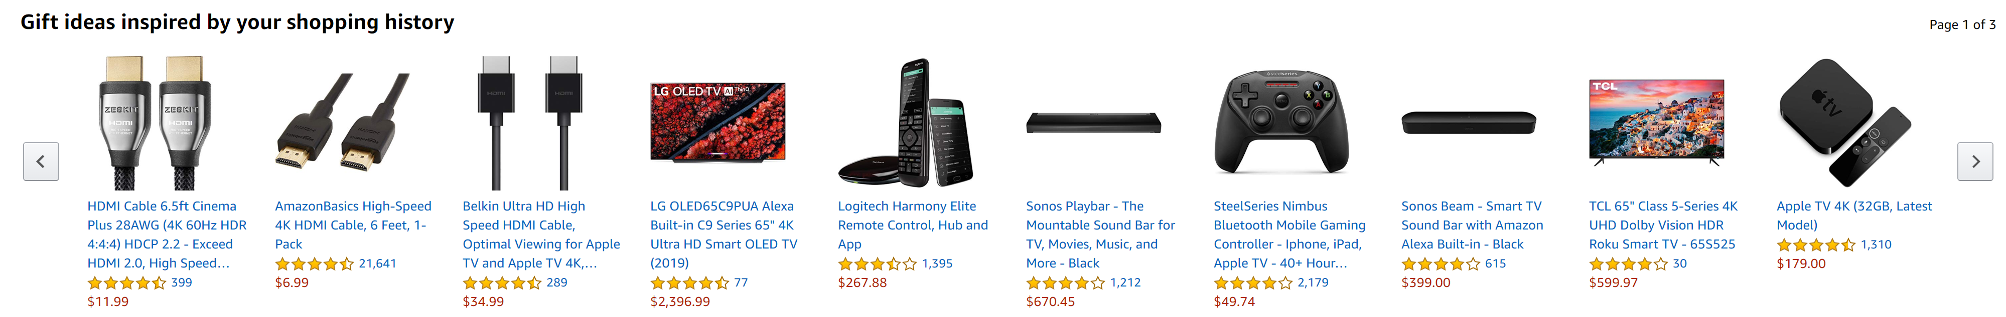
RECOMMENDATION ENGINE

Slide 79
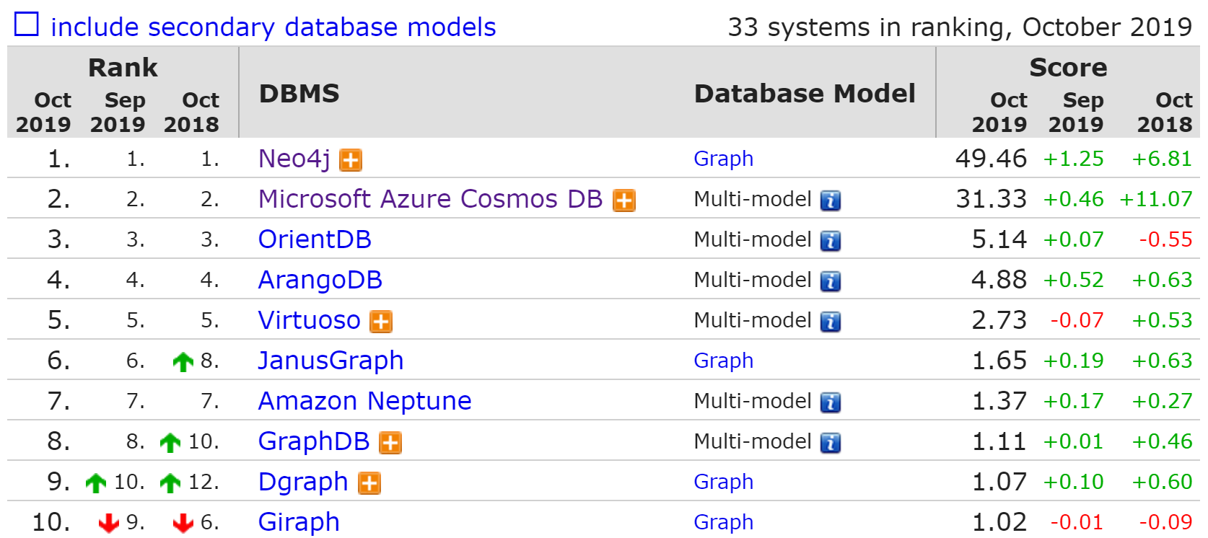
GRAPH DBMS RANK

Slide 80

PRACTICE

Slide 81
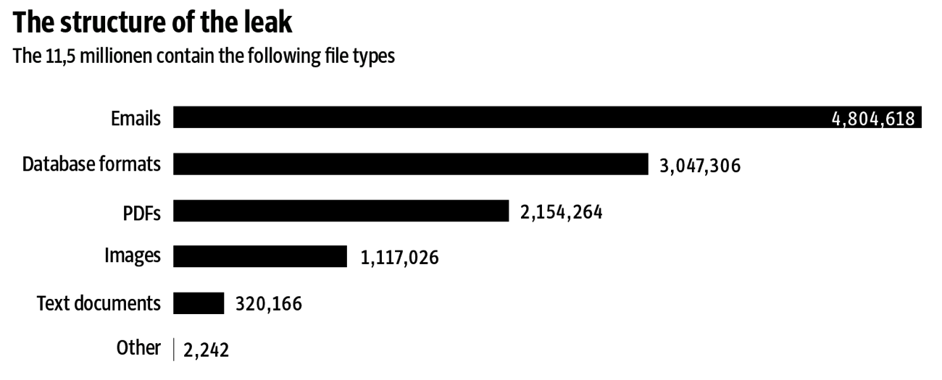
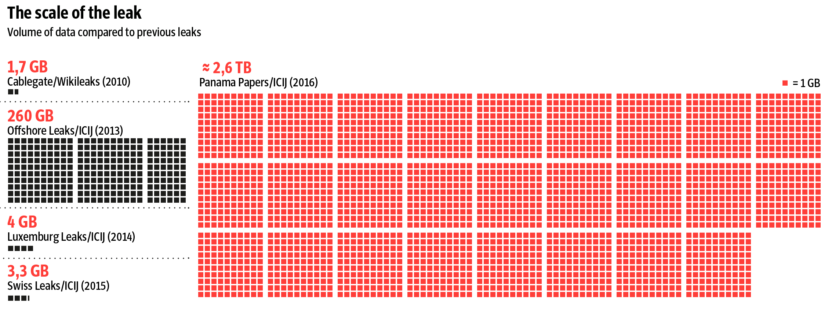
PANAMA PAPERS

Slide 82
PANAMA PAPERS – CLASSICAL FLOW
SCAN
OCR
DIGITAL TEXT
ETL
STRUCTURED DATA
RDBMS
SQL API
ANALYTICS
SOME STRUCTURED DATA
DATA MINING

Slide 83
WITH SEARCH ENGINE
Rich Document Parsing or NLP
Text Analysis
SCAN
SOLR +TIKA
DATA INGESTION
DATA INGESTION
DATA INGESTION
ANALYTICS
SEARCH ALGORITHM
SEARCH ALGORITHM
SEARCH ALGORITHM

Slide 84
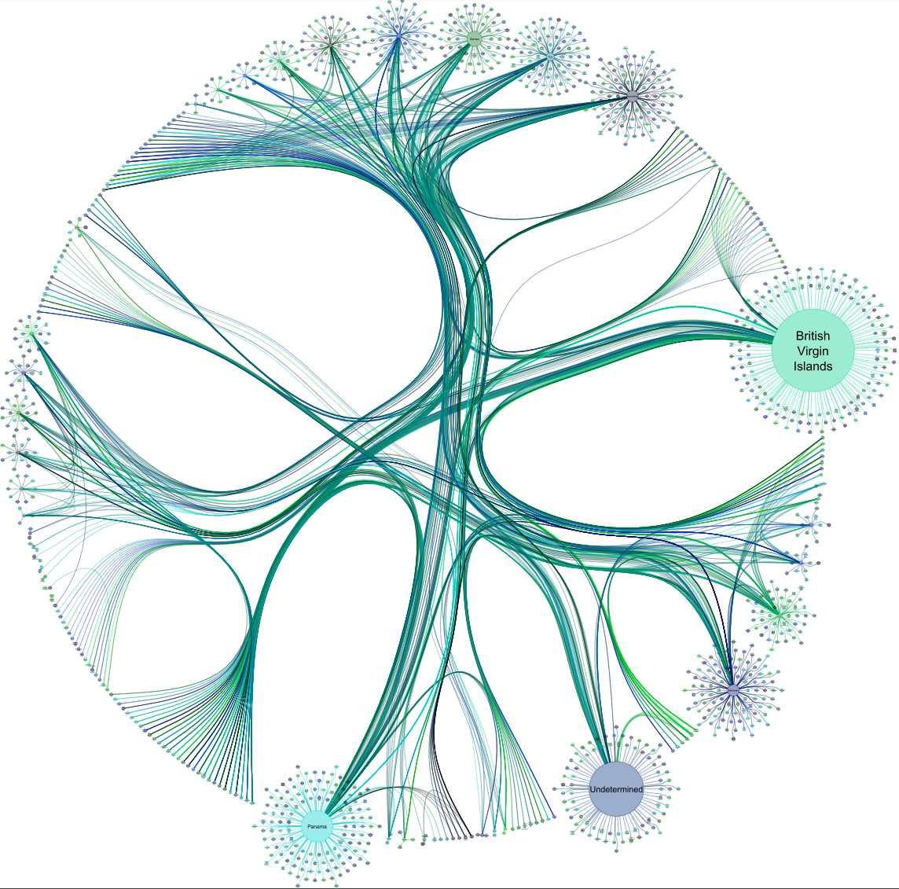

ADVANCED ANALYTICS
NEO4J
SOLR +TIKA
DATA INGESTION
DATA INGESTION
DATA INGESTION
ML
MODEL
SEARCH ALGORITHM
SEARCH ALGORITHM
SEARCH ALGORITHM

Slide 85
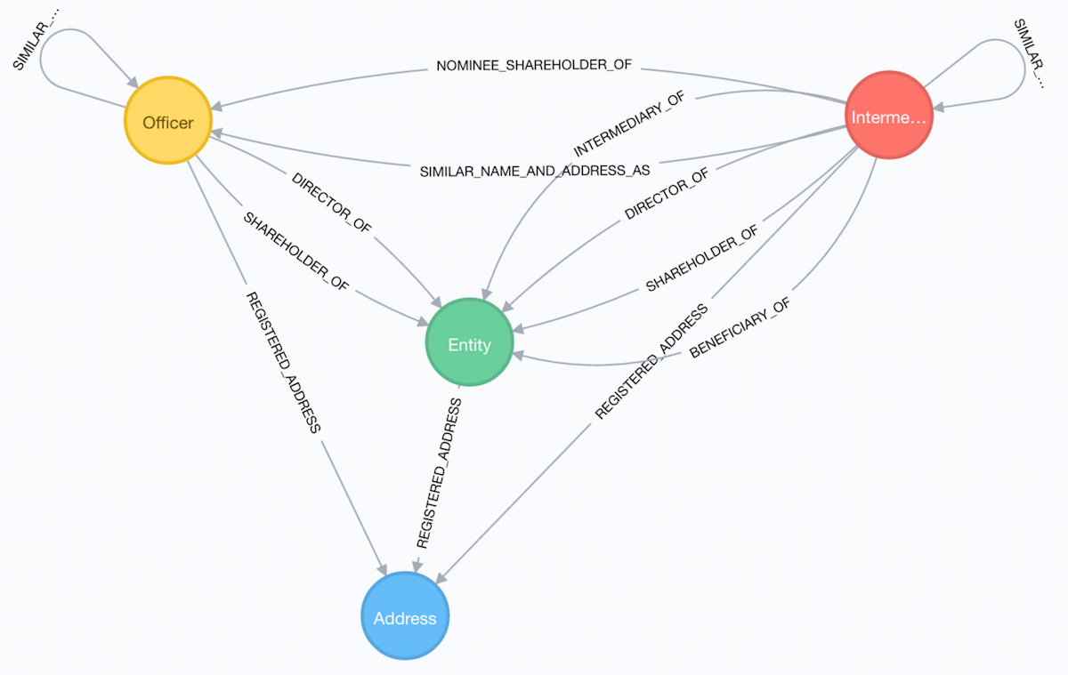
PANAMA PAPERS SCHEMA
Entity - The offshore legal entity. This could be a company, trust, foundation …
Officer - A person or company who plays a role in an offshore entity, such as beneficiary, director, or shareholder.
Intermediary - A go-between for someone seeking an offshore corporation and an offshore service provider — usually a law-firm or a middleman that asks an offshore service provider to create an offshore firm.
Address - The registered address

